Slide 1
Online Inspection of Packed Cases
PSCS69 Capstone Project
FINAL VIVA - VOCE
Batch Number: G-125
Student Name | Roll Number
B HARINATH REDDY | 20211CSE0845
D LAKSHMI NIRANJAN REDDY | 20211CSE0838
NOOKALA PAVAN KUMAR | 20211CSE0839
D SAI ESWARA REDDY | 20211CSE0516
K DINESH | 20211CSE0709
Under the Supervision of,
Dr./Mr./Ms./Prof. SUKRUTH GOWDA
Professor / Associate Professor / Assistant Professor
School of Computer Science and Engineering
Presidency University
Name of the Program: B. Tech
Name of the HoD: Dr. Asif Mohammed H.B
Name of the Program Project Coordinator: Dr. Amarnath J.L & Dr. Jayanthi K
Name of the School Project Coordinators: Dr. Sampath A K / Dr. Abdul Khadar A / Mr. Md Ziaur Rahman

Slide 2
Introduction
In the agricultural sector, ensuring the quality of packed products, such as crops and leaves, is crucial to maintain customer satisfaction. Current inspection processes are often carried out manually, which leads to inefficiencies and inconsistencies. This project proposes an automated solution using Artificial Intelligence (AI) and Image Processing techniques to inspect packed cases in real-time.
By automating the inspection process, the aim is to improve the accuracy, consistency, and scalability of quality assurance tasks, particularly focusing on Color, Ripeness, and Uniformity of the packed leaves. This project proposes an advanced Artificial Intelligence (AI) and Image Processing system to automate the inspection of packed cases, specifically focusing on agricultural products like leaves. The goal is to implement a system that can analyze key attributes such as color, ripeness, and uniformity of the packed cases in real-time, providing immediate feedback to factory operators.

Slide 3
Literature Review
“Deep Learning. MIT Press.”
Author : Goodfellow, I., Bengio, Y., & Courville, A.
Algorithm Used:
Deep Neural Networks (DNNs): The book covers a wide range of deep learning architectures such as Convolutional Neural Networks (CNNs), Recurrent Neural Networks (RNNs), and generative models like Generative Adversarial Networks (GANs).
Drawbacks:
Computationally Expensive: Training deep networks requires a lot of computational power and memory.
Overfitting: Deep networks can easily overfit, especially when trained on small datasets.

Slide 4
Literature Review
“YOLOv3: An Incremental Improvement.”
Author : Redmon, J., & Farhadi, A.
Algorithm Used:
Darknet-53 Backbone: YOLOv3 uses Darknet-53, a 53-layer convolutional neural network, as its backbone. This network is pre-trained on ImageNet, allowing it to perform feature extraction from images efficiently.
Drawbacks:
Lower Accuracy for Small Objects: Although YOLOv3 performs better on smaller objects than its predecessors, its performance on very small objects is still not as accurate as models like Faster R-CNN or SSD. Small objects may be missed or poorly localized.

Slide 5
Literature Review
“ImageNet Classification with Deep Convolutional Neural Networks.”
Author : Krizhevsky, A., Sutskever, I., & Hinton, G. E.
Algorithm Used:
Convolutional Neural Networks (CNNs): A CNN is a type of deep neural network specifically designed for processing structured grid data like images. CNNs use convolutional layers to automatically extract features from raw image data.
Drawbacks:
Sensitivity to Hyperparameters: AlexNet is very sensitive to hyperparameters like learning rate, batch size, and weight initialization.

Slide 6
Research Gaps Identified
Limited Availability of High-Quality Labeled Data
Gap: One of the biggest challenges in developing AI models, especially in highly specialized domains like crop or packed case inspection, is the availability of high-quality, labeled datasets. Most pre-trained models like YOLO or ResNet are trained on large-scale generic datasets such as ImageNet or COCO, which may not contain relevant images for specific industry applications (e.g., variations in crop color, ripeness levels, etc.).
Solution Approach: There is a need for industry-specific datasets that include diverse and labeled examples of packed cases, capturing variations in ripeness, color, and uniformity. Active learning and synthetic data generation methods could be explored to expand the dataset.

Slide 7
Proposed Methodology
Image Acquisition:
Images of each packed case are captured using high-resolution cameras installed at various inspection points in the factory.
Preprocessing and Data Augmentation:
The captured images undergo preprocessing, including resizing, normalization, and data augmentation, to make them compatible with the AI model and to improve model generalization.
AI Model - Conzavolutional Neural Networks (CNNs):
A pre-trained CNN model (such as ResNet or YOLO) is fine-tuned to classify the packed cases into different categories based on color, ripeness, and uniformity.
Feature Extraction:
The CNN extracts high-level features such as color distributions, ripeness status, and uniformity metrics from the images.

Slide 8
Objectives
Automate the inspection process for packed cases to increase the percentage of cases inspected from 10% to near 100%.
Enable real-time quality checks, reducing delays and providing opportunities for immediate corrective actions.
Ensure consistency and objectivity in quality assessments by eliminating subjective human judgment.
Implement a scalable solution that can adapt to different product types, particularly focusing on agricultural crops.

Slide 9
Methodology/Modules
Data Collection & Preprocessing:
Collection of images of packed cases in various conditions (good, bad, unripe, etc.).
Model Development:
A Convolutional Neural Network (CNN) will be developed and trained using TensorFlow and Keras on labeled images for packed cases.
System Integration:
The model will be integrated into a web application using Django for user-friendly image upload and real-time predictions.
Real-Time Processing:
The system will analyze uploaded images in real-time, providing instant feedback regarding the quality of the case.

Slide 10
System design and Implementation
Backend Design (AI Model)
AI Model Architecture: A pre-trained Convolutional Neural Network (CNN) model like ResNet, YOLO, or VGG is fine-tuned using a custom dataset of packed cases. The model is trained to classify images based on the following attributes:
Color Detection: The model predicts whether the case is predominantly red, green, yellow, or black.
Ripeness Detection: Determines whether the packed content is ripe, unripe, or damaged.
Uniformity: Measures the uniformity of the product’s appearance.
Model Training: The model is trained on a large, annotated dataset of packed cases, using Keras with TensorFlow as the backend.
Prediction Process: Once an image is processed, the model predicts the quality metrics (e.g., ripeness, uniformity, and overall quality status).

Slide 11
System design and Implementation
2.3 Frontend Design (User Interface)
Image Upload: The frontend web page provides an option for users to upload images of packed cases for inspection.
Real-Time Display: Upon uploading, users can see the prediction results instantly. These results include whether the case passed or failed inspection and a detailed breakdown of color, ripeness, and uniformity metrics.
Feedback Form: The system allows users to provide feedback on whether the results were accurate. If the user indicates that the inspection was incorrect, a message appears encouraging improvement.

Slide 12
Architecture
Frontend (HTML/CSS/JavaScript): The user interface for uploading images and viewing results.
Backend (Django): Handles image uploads, preprocessing, and communicates with the AI model.
AI Model (TensorFlow/Keras): A trained CNN model loaded into the backend for image classification.
Database (optional): Stores historical records of inspected cases and user feedback.

Slide 13
Hardware/software components
Hardware:
GPU (optional) for fast training of the CNN model.
Standard CPU for running the Django application.
Software:
Python 3.7+
Django Web Framework
TensorFlow/Keras for deep learning model development.
OpenCV for image preprocessing.
HTML, CSS, JavaScript for the frontend design.
Database (SQLite/MySQL) (optional for storing records).

Slide 14
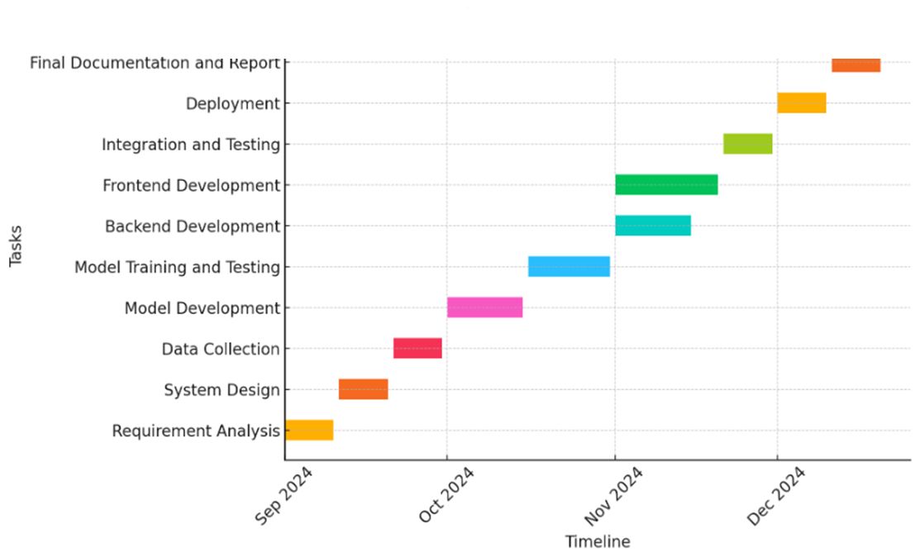
Timeline of Project

Slide 15
Expected Outcomes
Automated Real-Time Inspection: The system will enable automated and real-time inspection of packed cases.
Improved Efficiency: Inspection coverage will be increased from the current 10% to near 100%.
Objectivity in Inspection: The removal of subjective human judgment will lead to consistent and reliable inspection results.
Increased Customer Satisfaction: By ensuring only quality products are dispatched, the system will help maintain high customer satisfaction.

Slide 16
Conclusion
The proposed AI-driven system will automate the inspection process of packed cases, overcoming the current limitations of manual inspections. By integrating AI and Image Processing, the system can provide real-time quality assessments based on predefined standards such as color, ripeness, and uniformity.
The result is a more efficient, scalable, and consistent inspection process that can significantly enhance operational efficiency and customer satisfaction.

Slide 17
References
Goodfellow, I., Bengio, Y., & Courville, A. (2016). Deep Learning. MIT Press.
Redmon, J., & Farhadi, A. (2018). YOLOv3: An Incremental Improvement. arXiv preprint arXiv:1804.02767.
Krizhevsky, A., Sutskever, I., & Hinton, G. E. (2012). ImageNet Classification with Deep Convolutional Neural Networks. Advances in Neural Information Processing Systems, 1097–1105.
Zhao, Z., Zheng, P., Xu, S., & Wu, X. (2019). Object Detection with Deep Learning: A Review. IEEE Transactions on Neural Networks and Learning Systems, 30(11), 3212-3232
Rajpurkar, P., Jia, R., Liang, P. (2018). Know What You Don't Know: Unanswerable Questions for SQuAD.

Slide 18
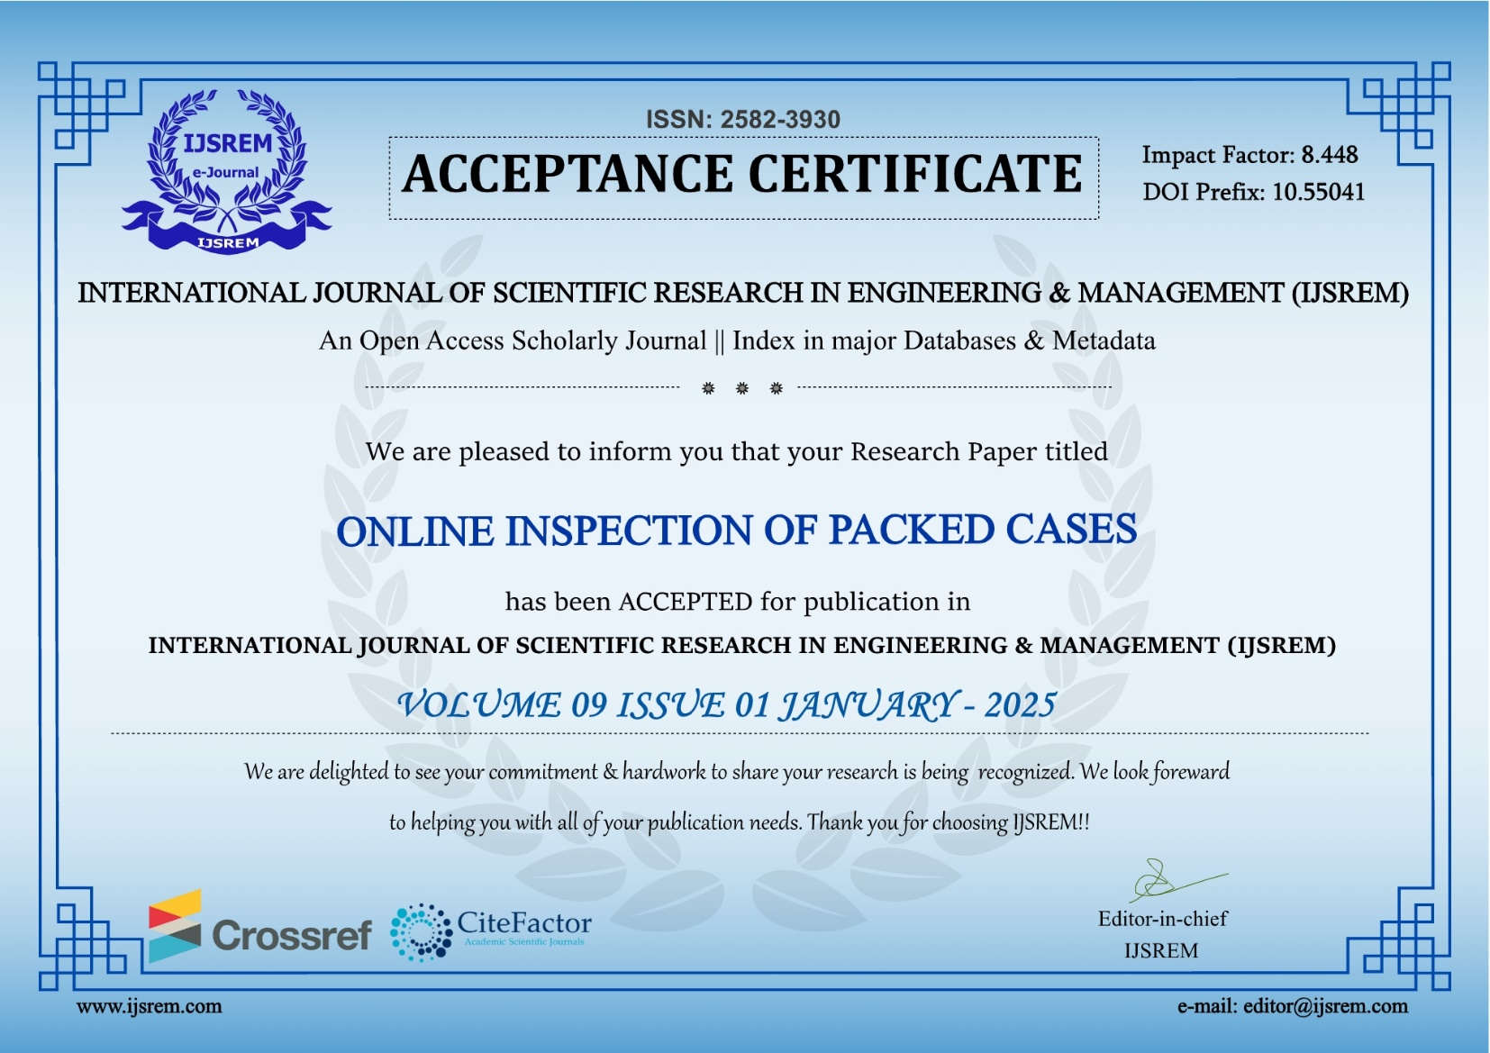
Publication Details

Slide 19
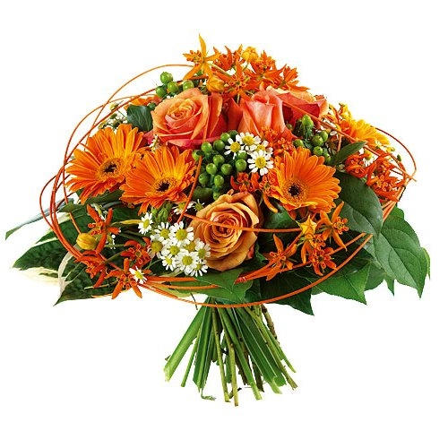
Thank You

